Slide 1

ACTL3143 Project
Image Classification of Australian Animals
William Li

Slide 2
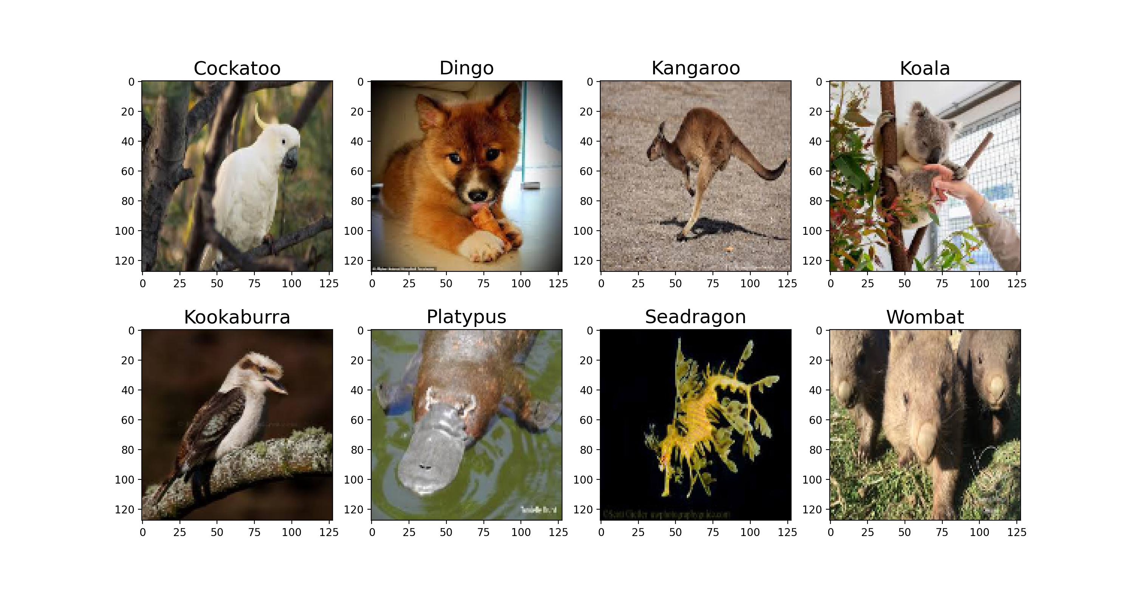
8 classes

Slide 3
Source of data
There are 200 images for each of the 8 animals
The data was downloaded from Google images with the help of the Image Downloader Chrome extension¹
I selected photos manually to ensure accuracy and try to avoid duplicates
1. https://chrome.google.com/webstore/detail/image-downloader/cnpniohnfphhjihaiiggeabnkjhpaldj

Slide 5
Simple Neural network architecture
Resize:
to 16x16x3
Flatten
Input:
128x128x3 Image tensor
Dense layer:
1024 neurons
Tanh activation
Dense layer:
256 neurons
Tanh activation
Output:
1 of 8 classes
Dense layer:
8 neurons
Softmax activation

